Slide 1
Lecture 6
Refrigeration & Liquefaction
J. G. Weisend II

Slide 2
Goals
Introduce basic concepts of cryogenic refrigeration & liquefaction
Describe the Carnot cycle
Define Coefficient of Performance and Figure of Merit
Describe practical helium refrigeration/liquefaction cycles
Present examples of typical cryogenic refrigeration equipment

Slide 3
Introduction
How do we get things cold?
In general, cooling is done by using a working fluid (in cryogenics this is almost always helium) and making it under go a closed thermodynamic cycle that removes heat at low temperature and rejects the heat at room temperature.
  This process requires work
  There are many thermodynamic cycles – we will only examine a few key ones
Here we will concentrate of refrigeration systems of ~ 100 W or greater
  Systems of less than ~ 100 W are known as cryocoolers and tend to use different cycles. These will be covered in a later lecture

Slide 4
Introduction
There are other approaches to cooling
  Non cryogenic refrigeration e.g. home refrigerators, AC etc – not covered here
  Very low temperature (<1.5 K ) approaches : Magnetic refrigerators, adiabatic demagnetization refrigerators, dilution refrigerators etc – will be mentioned (at least) later
Remember – no matter the technique, the Laws of Thermodynamics apply

Slide 5
Refrigerators vs. Liquefiers
Refrigerators are closed cycle systems
  They provide cooling and can create liquids but all the mass flow is returned to the start of the cycle
  Such systems are said to have “balanced flow”
Liquefiers are open cycle systems
  They provide a liquid which is then drawn off and used elsewhere
  These have “unbalanced flows” the amount of mass returned to the start of the cycle is less than the amount that started by the mass that was converted to liquid.
  In order to keep the cycle running this mass would have to be added as room temperature gas.

Slide 6
Refrigerators vs. Liquefiers
LHe or Cold He Gas Supply
LHe
LHe
LHe
Refrigerator
System
Liquefier
System
Cold He Gas Return
300 K He Gas
Open Cycle Liquefier
Closed Cycle Refrigerator
From Helium Cryogenics – Van Sciver

Slide 7
Refrigerators vs. Liquefiers
In practice, this distinction is less clear cut
  Modern cryogenic plants can operate either as refrigerators or liquefiers and in fact, generally operate as a mixture of the two.
  We talk about refrigeration loads & liquefaction loads
  A key issue is at what temperature is the boil off gas from a cryogenic liquid returned to the cycle?
    If brought back at a cryogenic temperature and used to cool incoming warmer gas then this is a refrigeration load
    If brought back warm and not used to cool incoming warmer gas this is a liquefaction load
The thermodynamic rules are the same for refrigerators and liquefiers

Slide 8
Consider the cooling of a superconducting magnet and its current leads
300 K He Gas
(Liquefaction Load)
Superconducting Magnet
Current lead flows
Cold He Outlet
(Refrigeration Load)
LHe Inlet
Superconducting
Magnet

Slide 9
Catching Cold
Before we get involved in thermodynamic cycles, let’s go over the basics
There are really only a few ways in which to make a pure fluid such as helium colder
  Cause the fluid to do work by making it expand against a piston or turbine while keeping it thermally isolated from the outside environment Isentropic Expansion
  Transfer heat from the fluid to a colder surface
  Cause the fluid to do “internal work” by expanding it through a valve while keeping it thermally isolated Isenthalpic Expansion
    Joule-Thomson expansion (more later)
  Once the fluid is a liquid, reduce the pressure above the fluid below atmospheric pressure thus reducing the saturation temperature
All modern cryogenic plants do the first 3. Ones that provide cooling below 4.2 K also do the last item

Slide 10
Carnot Cycle
This is an ideal cycle: all processes are reversible
  Entropy is only changed by absorbing or removing heat at constant temperature
  2nd law of Thermodynamics, in a reversible process dQ = -TdS
The Carnot Consists of 4 steps
  Compress the working fluid isothermally at T_{H} (1-2)
  Expand the working fluid isentropically from T_{H} to T_{C} (2-3)
  Absorb heat into the working fluid isothermally and reversibly at T_{C} (3-4)
  Compress the working fluid isentropically from T_{C} to T_{H} (4-1)
  Note isentropically = reversibly and adiabatically

Slide 11
Carnot Cycle
T
T_{H}
2
1
T_{C}
3
4
Q
S
s₁
s₂
How do we describe the performance of such a cycle?

Slide 12
Coefficient of Performance
& the Carnot Cycle
Coefficient of Performance: the heat absorbed from the cold sink divided by the net work required to remove this heat
  Minus sign takes into account that the heat absorbed by the cycle is positive while the work do is negative
Since this is a closed cycle, the net work done is equal to the net heat transferred. Since this cycle completely reversible, the 2nd law gives the net heat transferred as:

Slide 13
Coefficient of Performance
& the Carnot Cycle
Thus
Again from the 2nd Law:
Thus, for the Carnot cycle the COP may be written as:
  For the Carnot cycle the COP is dependent only on the temperatures

Slide 14
Coefficient of Performance
& the Carnot Cycle
For a plant operating between room 300 K and 4.2 K, the Carnot COP is
4.2/( 300 – 4.2) or 0.0142
The Carnot cycle is the ideal case. It is the best you can do without violating the laws of thermodynamics
Note that the form of the Carnot COP shows that you have a better COP (thus a more efficient process or refrigerator) if T_{C} is large
  It is always thermodynamically more efficient to intercept heat (provide cooling) at higher temperatures
  This fact drives a lot of cryogenic design
In practice, we generally discuss the inverse of the COP because this allows us to describe the number of watts of work required to provide 1 Watt of cooling at a given temperature. For a Carnot cycle providing cooling at 4.2 K. This is 70 W/W
  People will frequently and incorrectly refer to this as a COP as well

Slide 15
Carnot Cycles & the Real World
Can we build a real machine using a Carnot cycle?
  In a word NO
Why?
  Compressing a fluid isothermally is very hard to achieve, Normally the fluid is compressed and then cooled back down to 300 K
  Expanding or compressing fluid isentropically is basically impossible
  We can absorb heat into a boiling fluid isothermally but not with out irreversible losses
How close can we get to Carnot? We define the Figure of Merit (FOM) as:
  We also speak in terms of “percent Carnot” i.e. FOM of 0.2 is 20% Carnot

Slide 16
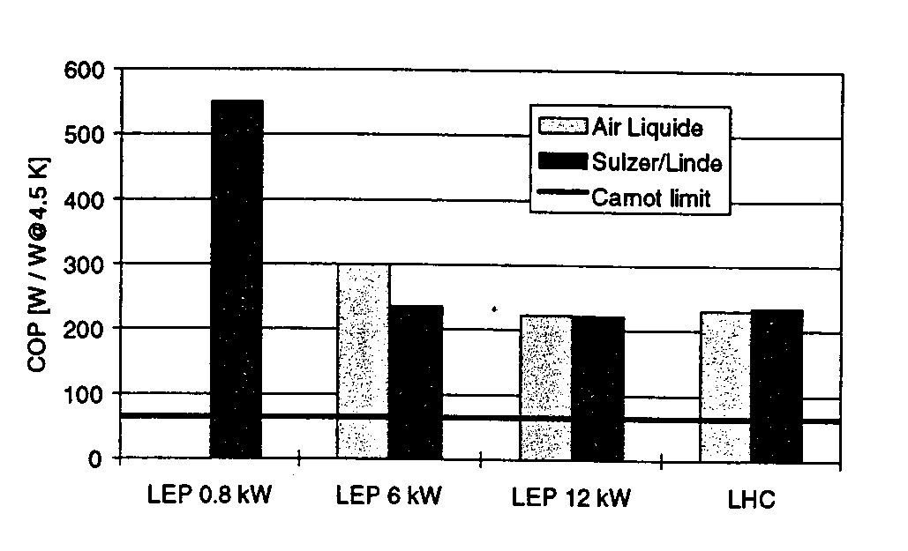
The real world is sometimes not kind to cryogenic engineers
These are state of the art helium refrigerators. Note that the best of them (for LHC) runs at about 220 W/W or a FOM of 0.318 or at 32% Carnot

Slide 17
Practical Impact of Plant Performance
How much power does it take to operate a large cryogenic refrigeration plant?
AT ESS we have a refrigeration plant capable of removing as much as 9 kW at 4.5 K. The FOM of the plant is measured to be expected to be 0.25
If the plant operates as expected this means we will need:
(66/0.25) x 9000 = 2.4 MW of mechanical power
We added some additional margin to the electrical power requirements and have at least 2.6 MW available for powering the compressors

Slide 18
Joule-Thomson Expansion
Isenthalpic (h=constant) expansion
Fluid cools as is it is expanded at constant enthalpy through a valve
However, depending on both the fluid and the temperature, such an expansion can also cause heating.
Define the Joule-Thomson expansion coefficient
μ_{j} must be positive for cooling to occur
Cooling by JT expansion has some advantages
  No moving parts
  Can easily handle two-phase mixtures

Slide 19
JT Inversion Curve & Maximum
Inversion Temperatures
Fluid | Max Inversion Temperature (K)
Nitrogen | 623
Argon | 723
Hydrogen | 202
He | 43
Maximum inversion temperature for helium is 43 K
Note that below ~ 2 K He again warms on JT expansion
Many fluids, such as N₂ can be liquefied using JT expansion – JT cycle
Inversion curve for Helium

Slide 20
Joule-Thomson Refrigerator
From Cryogenic Systems
R. Barron
Simple
Mainly used for cryocoolers (more later) and not for large plants
Also known as a Linde-Hampson Refrigerator

Slide 21
Practical Large Scale Helium
Refrigerators (at last)
Modern large scale helium refrigerators/liquefiers use a variation of the Claude cycle known as the Collins cycle
The key difference between these cycles and the JT cycle is the addition of expansion engines (pistons or turbines) that the fluid does work against and thus cools
The process through these expansion engines may be idealized as Isentropic (s = constant) expansion
  Cooling occurs at any temperature
  ΔT for a given ΔP is much larger than for isenthalpic expansion
Claude cycle = 1 expansion engine, Collins cycle = multiple expansion engines
  The post WW II development of the Collins liquefier revolutionized laboratory research in cryogenics

Slide 22
Claude Cycle
From Cryogenic Systems
R. Barron

Slide 23
Collins Cycle
Cycle consists of :
  1) Compression to ~ 16 Bar with cooling back to 300 K + oil removal
  2) Cooling of high pressure gas with LN₂ or expansion turbine flow
  3) Isentropic expansion via 2 or more expansion turbines
  4) Cooling of high pressure gas by the cold returning low pressure stream
  5) Isenthalpic expansion through JT valve
  6) Return of gas to compressors at just above 1 Bar

Slide 24
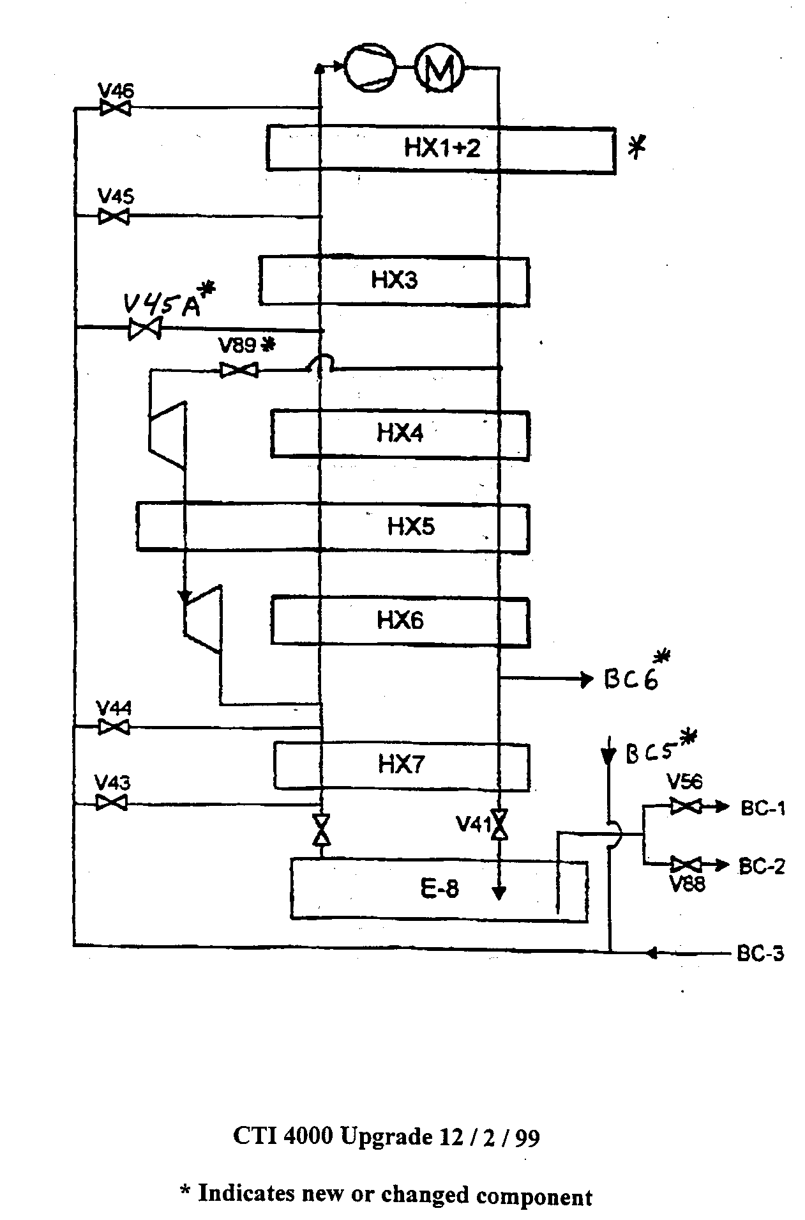
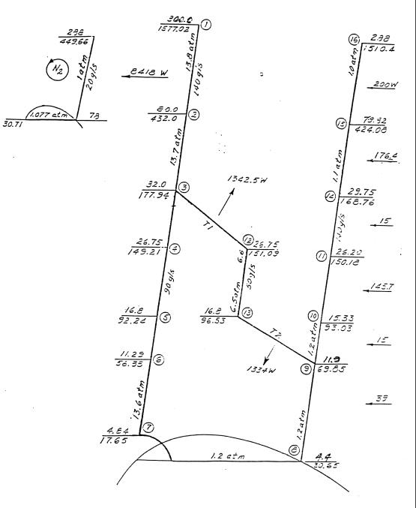
CTI 4000 Refrigerator
(early 80’s vintage ~ 1.2 kW @ 4.5 K)

Slide 25
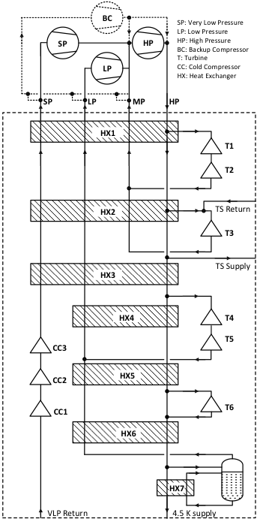
ESS Accelerator Cryoplant (2016) up to 3 kW cooling at 2 K
Note:
No LN₂ Precooling
Large number of expansion
turbines – some in series with
HP stream
3) Intermediate temperature
shield cooling
4) Medium pressure return
5) Last stage of subatmospheric
pumping is warm
System uses 3 cold compressors + 1 warm sub-atmospheric compressor for 2 K cooling

Slide 26
Major Components of a Helium
Refrigeration Plant
Helium Screw Compressors
  Operate at room temperature
  Are oil flooded – compress a mixture of He gas and special oil
  Require water cooling to remove heat due to compression
  Vast majority of power goes here
  We expect the largest compressors at ESS to use 1.2MW motors
From Dunham Bush Co.

Slide 27
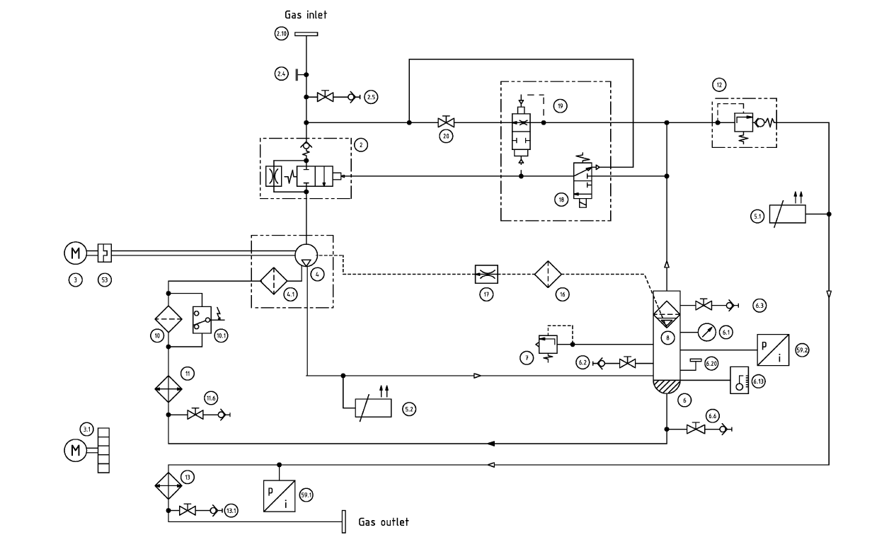
Schematic of a Helium Compressor
Combined control venting valve
non return valve
inlet valve
Compressor (screws)
bulk oil separator
oil filter
oil cooler
gas cooler
Courtesy Linde/Kaeser

Slide 28
Major Components of a Helium
Refrigeration Plant
Oil Removal Systems
  Removes oil down to the ppb level – critical for proper operation of the plant
  Bulk Oil Separators: should reduce level down to < than 250 ppm
  Coalescers: two or more in series reduce oil level down to < 10 ppm
  Absorbers:
    contain activated charcoal
    Are redundant
    Reduces level down to < 1 ppb
    Can be regenerated via warm N_{2 gas}

Slide 29
Typical Oil Separation System
(from G. Gistau Cryogenic Helium Refrigeration)

Slide 30
ESS ACCP Compressor System

Slide 31
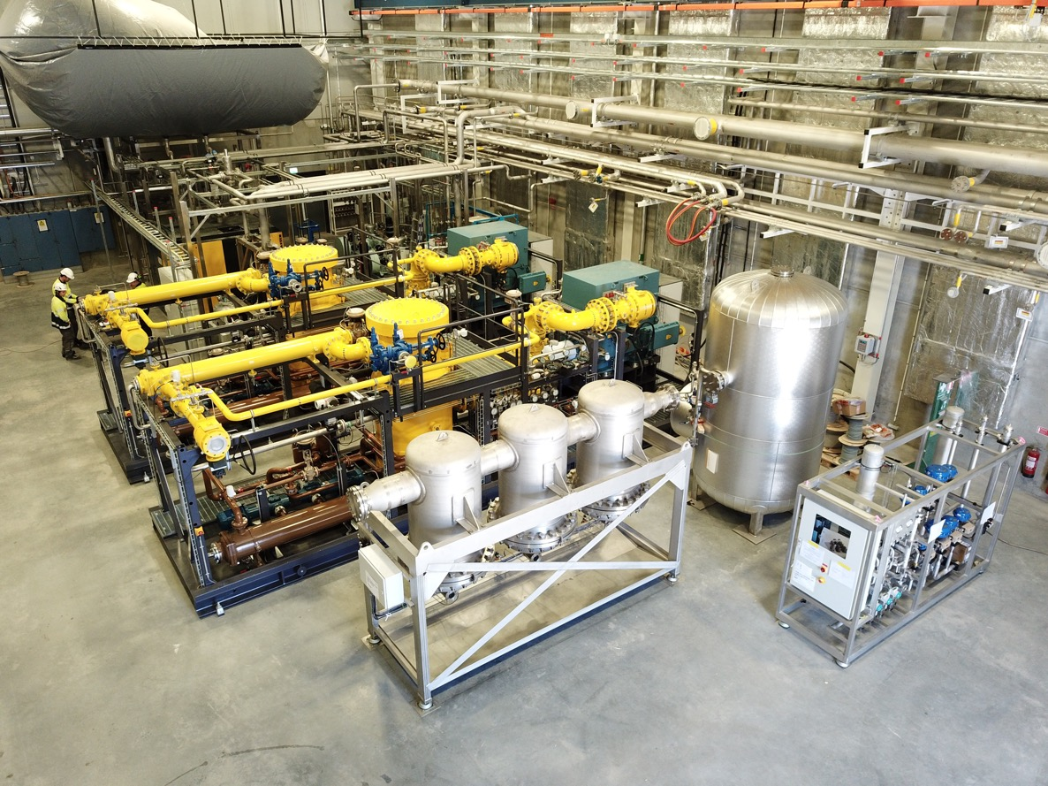
TMCP Warm Compressor and
Oil Removal Skids in Compressor Hall

Slide 32
Brazed Plate Fin Heat Exchangers
All aluminum
Vacuum brazed
Very compact
High efficiency
Can handle multiple streams
Standard for cryogenic plants
From The Handbook of Cryogenic Engineering
Courtesy Linde

Slide 33
Expansion Turbines
One of the key technologies for cryogenic plants
Proprietary designs resulting from a significant amount of R&D
Modern ones are quite reliable
Water cooling is generally required to absorb work at room temperature
May operate at speeds up to 120,000 rpm
Two primary suppliers: Air Liquide and Linde

Slide 34
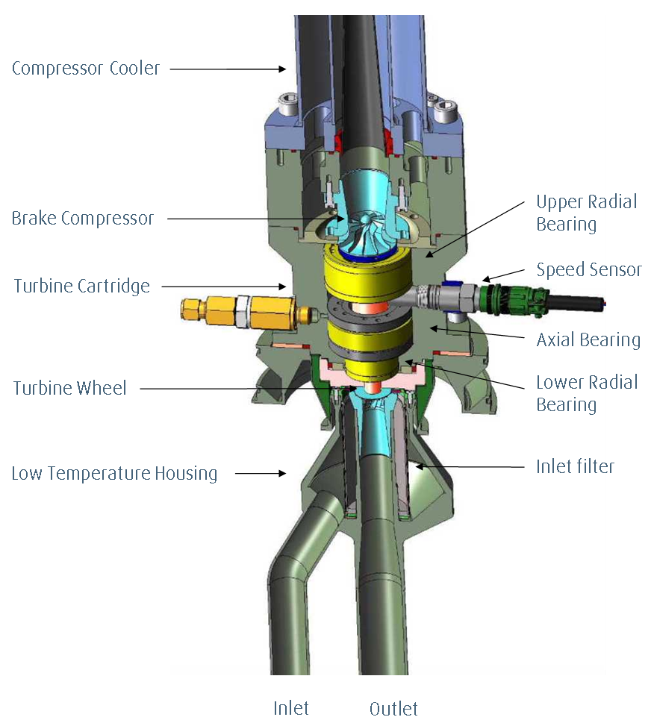
Examples of Expansion Turbines
Courtesy Air Liquide
Courtesy Linde

Slide 35
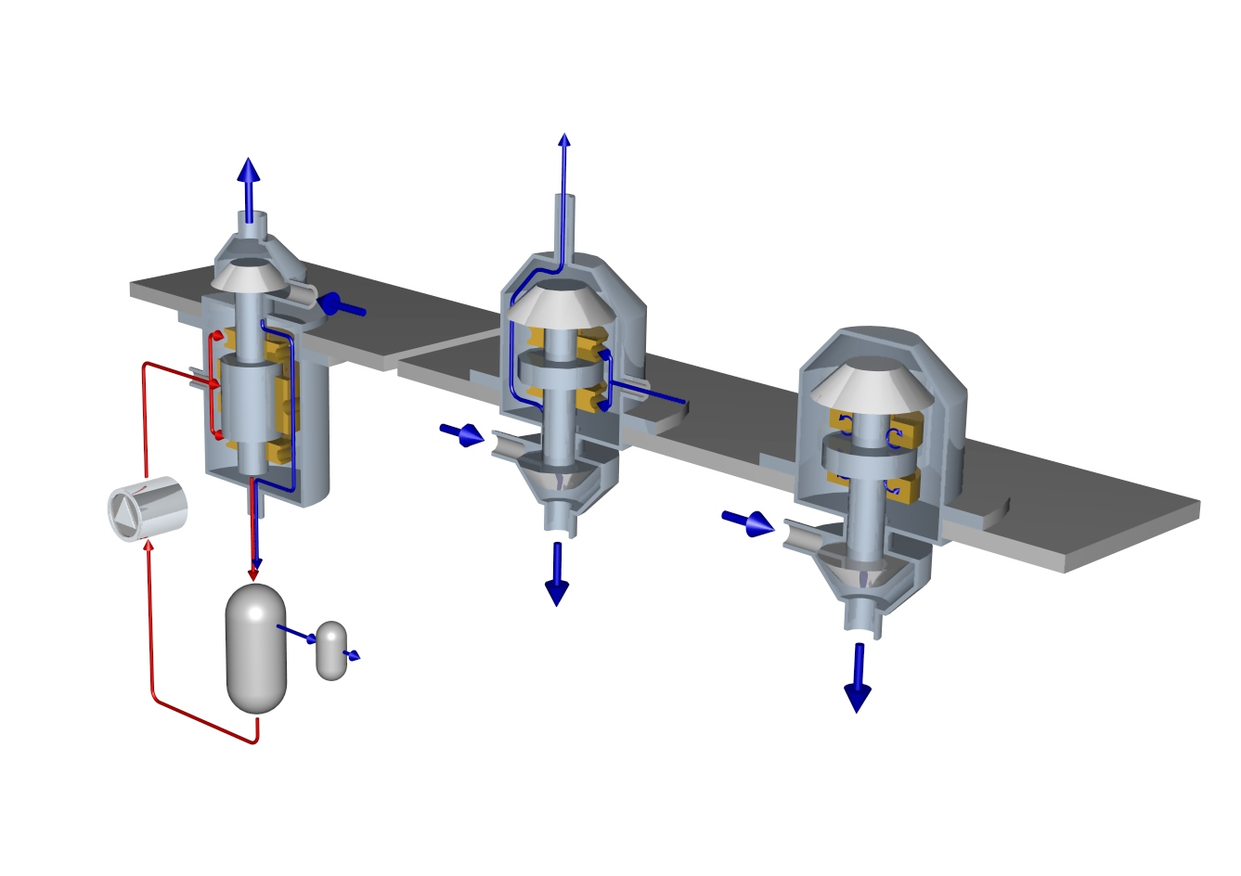
Expansion Turbine Bearing Options
(Gas bearings are the most common now)
Oil Bearing
Static Gas Bearing
To Compressor
Turbine
Dynamic
Gas Bearing
Oil
Sealing Gas
Turbine
Turbine
To Compressor
Courtesy Linde
Courtesy Linde

Slide 36
Major Components of a Helium
Refrigeration Plant
Cold Box
  Contains cryogenic components
    Heat exchangers
    Valves
    Expansion Turbines
    Piping
    Vacuum insulated

Slide 37
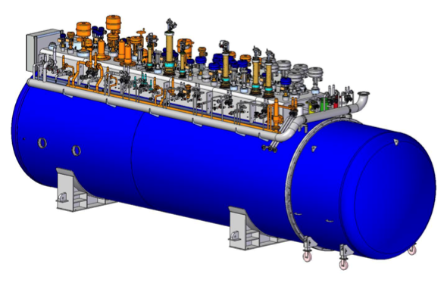
Accelerator Cryoplant
Cold Box
One Coldbox comprising 6 expansion turbines, 3 cold compressors, built-in acceptance test equipment
Notes:
Contract signature pending (expected March 2015), contract value < 20 million EUR (excluding installation, LHe Dewar, warm gas storage etc.)

Slide 38
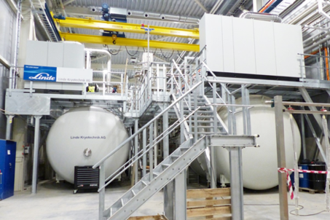
ESS Cold Boxes
Accelerator Cryoplant (Right) 3 kW @ 2 K
Target Moderator Cryoplant (Left ) 30.3 kW @ 16 K

Slide 39
Major Components of a Helium
Refrigeration Plant
Main Distribution Box
  Connects refrigeration plant with the distribution lines
Storage vessels (LN2, LHe, GHe)
Purifier: separate system that removes impurities from the helium space of the cryogenic system, including piping and items being cooled
  Contamination control is very important to reliable operation
Control System
  Generally PLC based with a higher level HMI
  Once fully commissioned, modern Helium refrigeration plants can operate autonomously 24/7

Slide 40
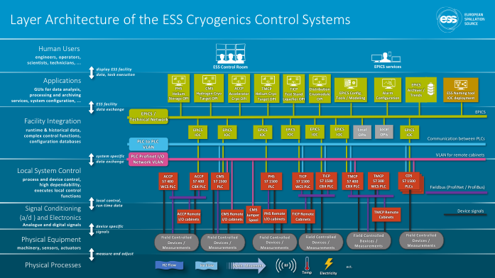
Typical Modern Cryogenic Controls System

Slide 41
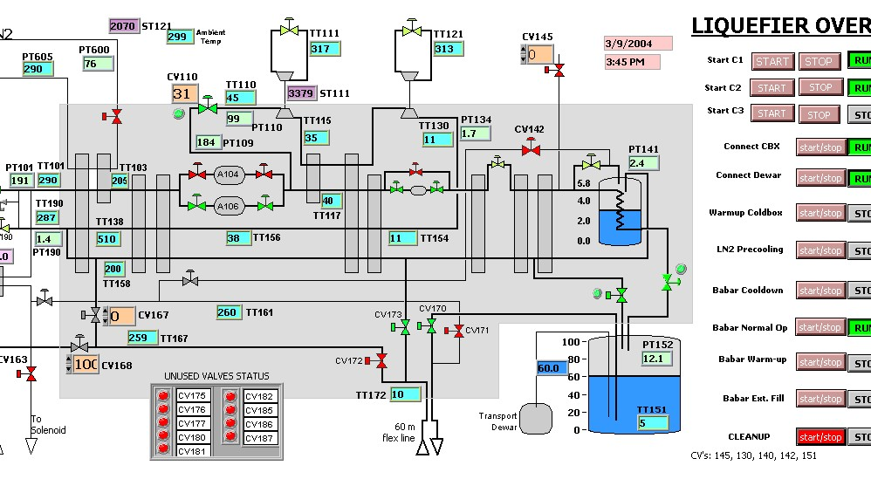
BaBar Liquefier Control Screen
SLAC

Slide 42
Sizing of Cryoplants and Margin
Given the long lead time in ordering and commissioning large cryoplants you may need to place the order or start design (if done in house) prior to knowing all the cryogenic loads.
AT ESS we used the following to determine needed capacity
C = F_{o} (F_{ud} Q_{d} + Q_{b} + F_{us} Q_{s})
C is the total capacity of the plant at a given temperature
F_{o} is the operational safety factor. This value sets to 1.15 gives us some margin within which to control the plant as well as providing some margin for suboptimal plant performance
F_{ud} is the safety factor for the dynamic heat loads associated with the superconducting RF (SRF) cavities. In the case of the ACCP, this value is set to 1.0 as the SRF cavity head loads are calculated assuming a fairly poor performing cavity. That is, the safety factor is already built into the estimated cavity dynamic heat load.
Q_{d} is the SRF cavity dynamic heat load.
Q_{b} is the heat load caused by beam losses in the accelerator. This is fixed at 1 W/m. The accelerator is not allowed to operate at higher beam losses and thus no additional safety factor is required
F_{us} is the safety factor associated with static heat loads. This is set at 1.5. ( it typically is between 1.5 – 2 depending on design maturity)
Q_{s} is the static heat load

Slide 43
Best Practices for
Cryplant Procurement
Start early
Optimize the overall cryogenic system and use this to define cryoplant requirements
  Include safety venting and off nominal operations at the start of design
Consider the use of industry studies to aid in the development of specifcations
Put proper effort into development of technical specifications
  Use previous specifications as models
  Review by outside experts

Slide 44
Best Practices For
Cryoplant Procurement
Work closely with vendor during design, construction, installation and commissioning
  Reviews
  Participation of technicians in commissioning
  Build up in house staff early to allow for this approach
Keep in mind effort and time needed to optimize control systems
Consider computer simulation of the final system to try out operating strategies, response to upsets etc.
Don’t underestimate the complexity of the warm portion of the He system

